Slide 1

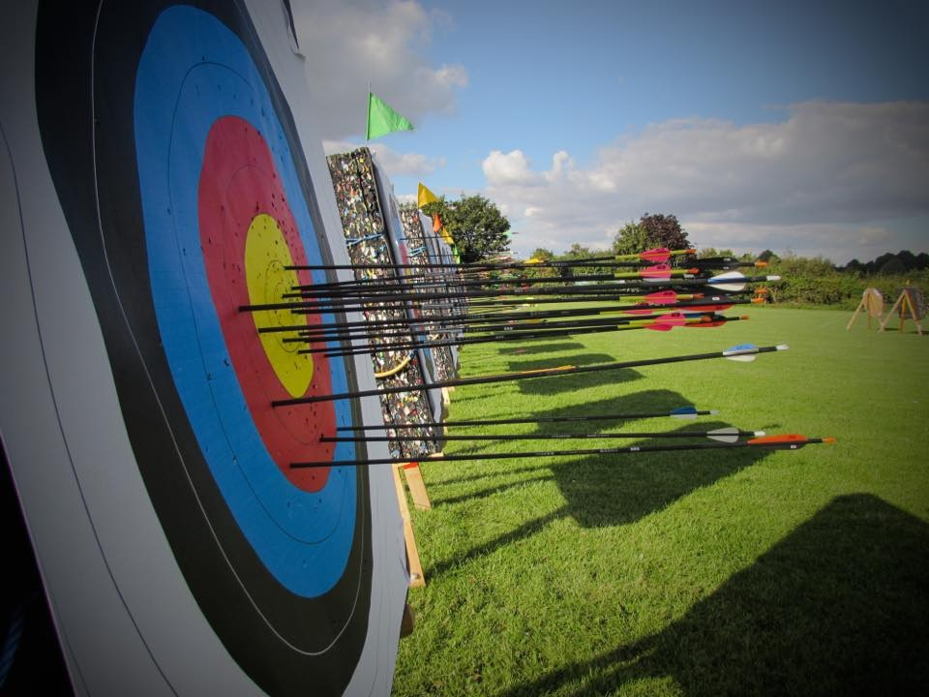
Bow setup and why we do it

Slide 2

Why the need to set up the bow?
Accuracy
  Safety
    Consistency
      Optimise the bow’s performance
        Get the arrow to fly straight
          Increase efficiency and power delivery
            The fundamental first stage of bow tuning.

Slide 3
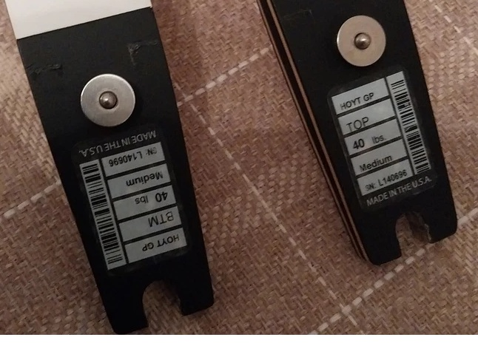
How to identify top and bottom limbs
Check for markings: Look for any writing on the inside of the limbs (the side facing the string).
Top limb: May have make and model graphics or logos, usually on the outside of the limb. The limb facing the archer is usually free of graphics or writing. The inside of the limb may have writing, such as the bow's statistics.
Bottom limb: The inside of the limb will have writing, such as the bow's statistics.
Use the text orientation: If you can only read the text when the limb is correctly oriented, that is a clear indicator.
Step 1. Correctly fit the limbs

Slide 4
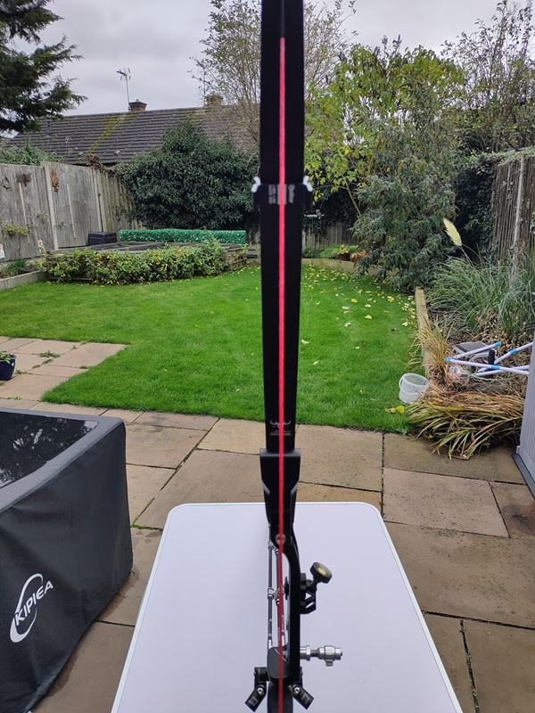
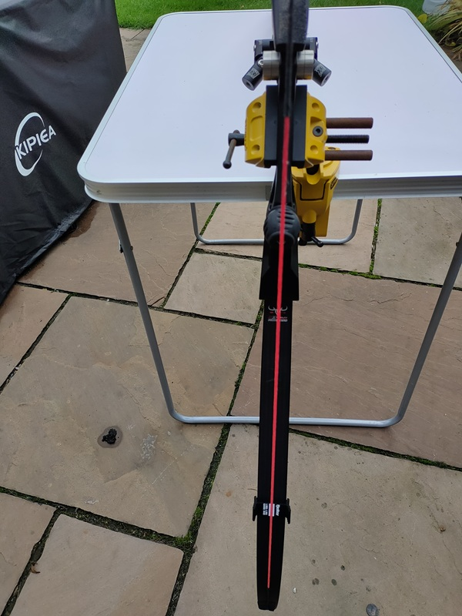
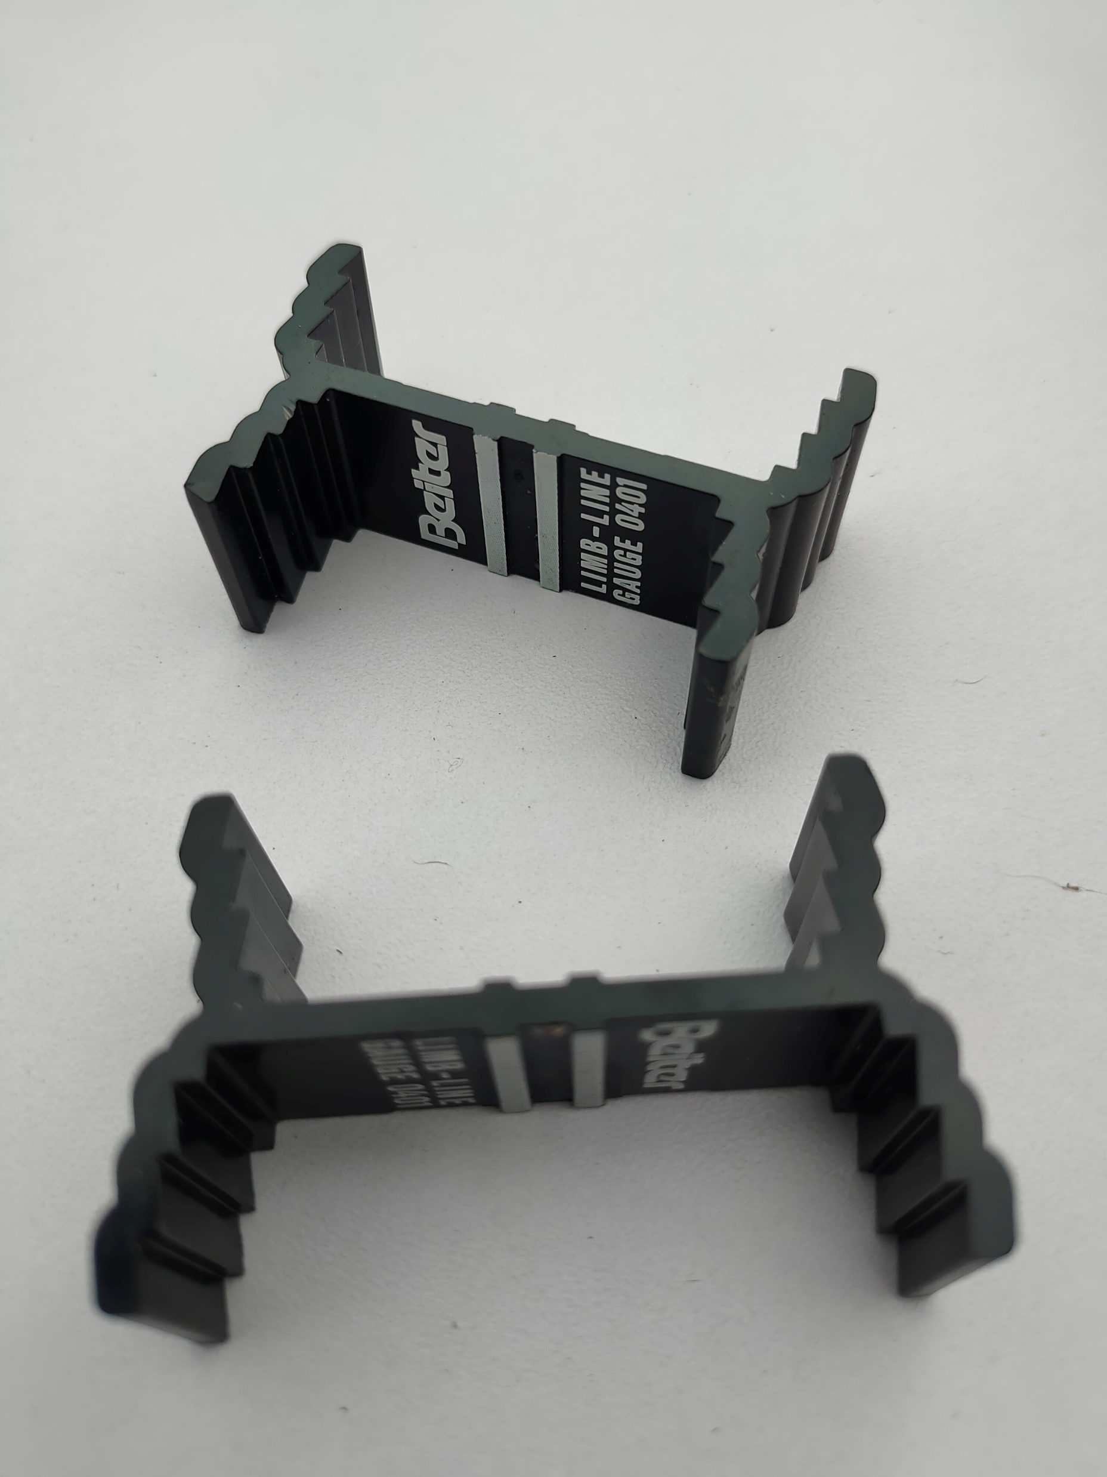
Step 2. Bow alignment
Bow alignment is ensuring that the riser and limbs are in a straight line and not twisted.

Slide 5
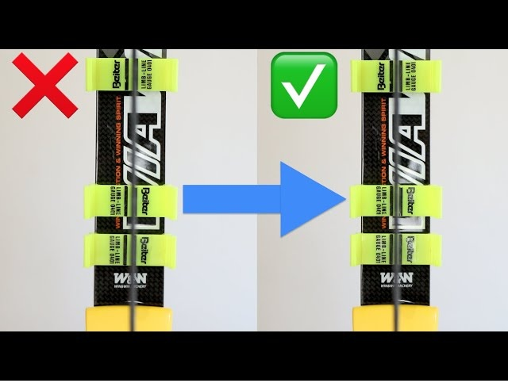
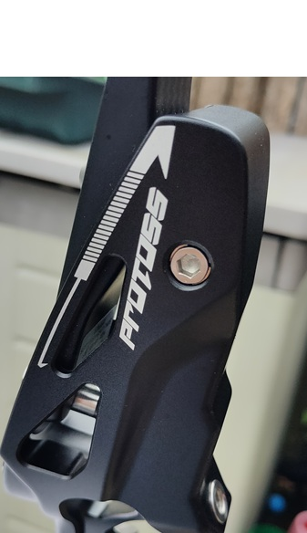
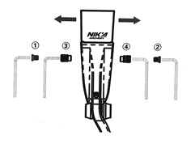
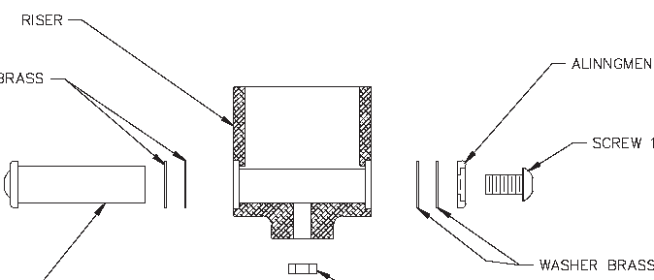
Step 2. Bow alignment
To centralise, adjust riser limb bolts to move the limb alignment to the left or right as required. Do this with the bow de-strung.

Slide 6
Step 3. Brace height
The brace height directly impacts a bow's performance, affecting arrow speed, hand shock, noise, and overall accuracy. A proper brace height ensures a more consistent and forgiving shot, while an incorrect height can lead to reduced accuracy, increased vibration, and potentially even "wrist slap" from the string.
A low brace height generally leads to a faster arrow but can lead to more vibration and noise.

Slide 7
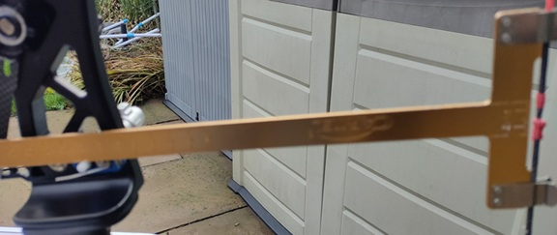
Step 3. Brace height
The brace height is measured with a bow square. As a start point set the brace height approximately at the mid point as described in the riser manual. If you don’t have the manual, set between about 21cm (8 ¼”) and 24.25cm (9 ½”).
Adjust the brace height by adding or removing twists in the bowstring

Slide 8
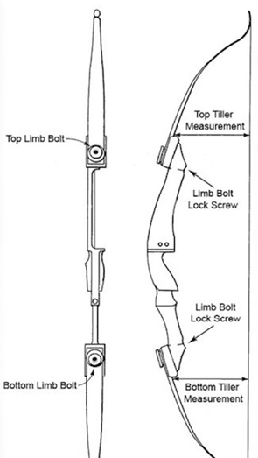
Step 4. Set the tiller
The tiller is the measurement from the point where the limb enters the riser and the bowstring
For Olympic style, the top tiller will lead the bottom tiller by around 5mm. For Barebow, particularly for string walkers, the bottom tiller will usually lead the top tiller

Slide 9
Step 4. Set the tiller
The aim is to have the limbs come to the brace position at the same time as (for recurve) the bottom limb will be flexed slightly less than the top as the point of draw is above the centre point of the bow. For barebow, particularly string walkers, the top limb will quite often be flexed less, hence a negative tiller.
Also, the bottom limb is often a little heavier to add balance or even slightly longer, however, some makes they are the same.

Slide 10
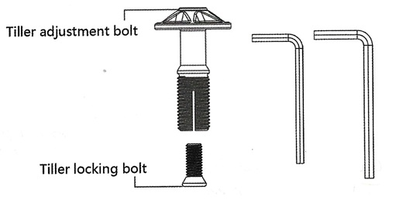
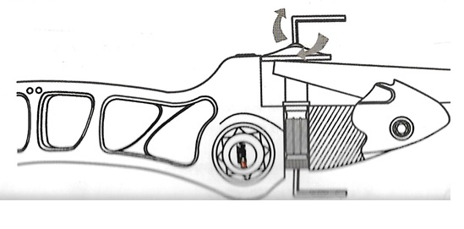
Step 4. Set the tiller
To adjust the tiller, first, destring the bow.
Loosen the locking bolt in the riser behind the tiller bolt.
To increase the tiller measurement: loosen the limb bolt
To lower the tiller measurement: tighten the limb bolt
Don’t forget to retighten the locking bolt when finished

Slide 11
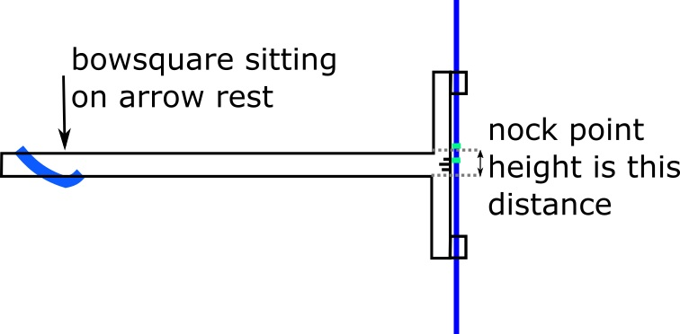
Step 5. Set the nocking point
The correct setting or the nock point will allow the arrow to leave the bow without contacting the bow at it leaves the bow, also as the bowstring comes to the rest position the arrow nock should be pushing the arrow along the arrow.
Generally, set at approx. 5-8mm (3/8”-5/16”)
If using brass nocks, don’t crimp too tight so you can adjust later

Slide 12
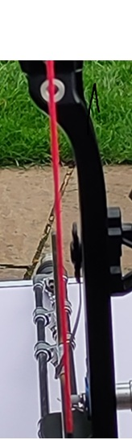
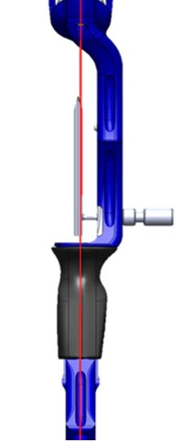
Step 6. Centre shot (right-handed archer)
The centre shot setup is to position the arrow such that on release the arrow will fly in a straight line from the string through the centre of the bow.
This involves adjusting the arrow rest and pressure button such that the arrow sits just to the left of the centre line of the string.

Slide 13
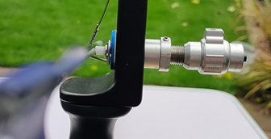
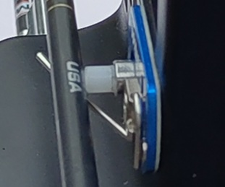
Step 6. Centre shot
As part of the centre shot, ensure that the arrow sits on the arrow rest and is touching the pressure button on the centre of the button
Also, the pin of the arrow rest should not protrude too far from beneath the arrow.

Slide 14
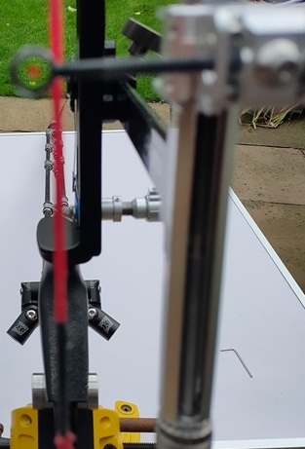
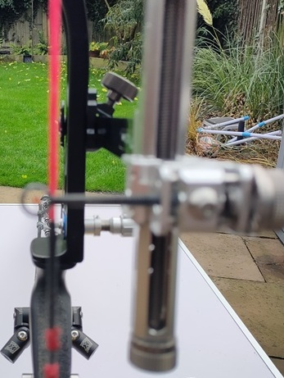
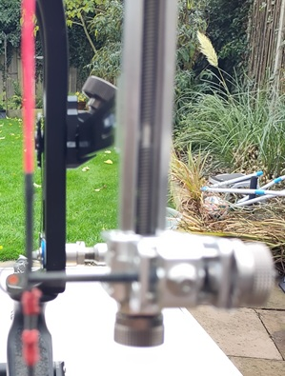
Step 7. Set sight position (right-handed archer)
Invert the sight and set the sight pin to float just to the left of the bowstring
Move the sight block from top to bottom and ensure that the sight pin remains by the string.

Slide 15
The bow should now be ready to go to the active tuning stage

